Slide 1
Capstone project IBM
Hazem Alaa Shams

Slide 2
Introduction
Relocating for work can be intimidating – even more so when you have to relocate to another country which you have never been to before and now you have to take your partner or family into account as well. It’s an overwhelming life event that makes you start thinking - what should I do, where do I begin and how do I approach this? The idea for this Capstone Project is to show how leveraging location data from FourSquare and other data sources can assist you with making decisions based on your individual needs when having to relocate.

Slide 3
Problem
He starts off by listing his and his family's basic wants and needs to identify how to approach the problem and to identify what data is required.
Security | To live in a safe environment
Close to working locations | Must have loads of restaurants in the area, Close to Museum
Public Elementary school | Neighborhood close to school

Slide 4
Data
From the basic wants and needs list in the scenario description the following data is required
1. Crime data 2. School data 3. FourSquare data on restaurants and work location
Open source data from Analyze Boston is obtained which is the City of Boston's open data hub. From here the crime data is obtained as well as school data. This will assist in identifying safe neighborhoods to live in as well as where the options are for Elementary schools.
The FourSquare API to query is used for geographical data on restaurants. It will be ideal to stay in the neighborhood or close to the neighborhood where there are many restaurants as a potential work option for the wife. FourSquare is also used to identify the location of the museum so that it can be taken into consideration when identifying possible neighborhoods to minimize extensive travel where possible. For each dataset used in this study a similar approach is followed to first explain where the data comes from, what is contained in the data and how the data is prepared in order to start working with a clean dataset.

Slide 5
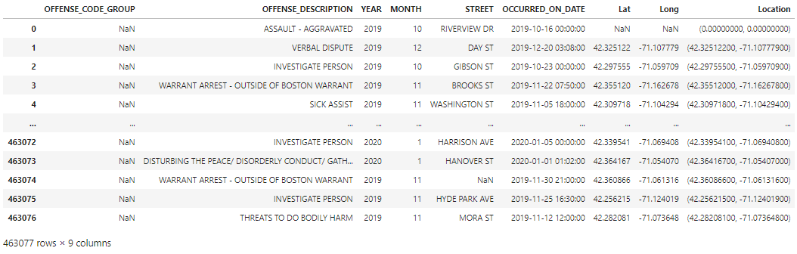
Boston Crime Data

Slide 6
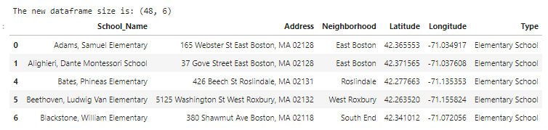
Boston School Data

Slide 7
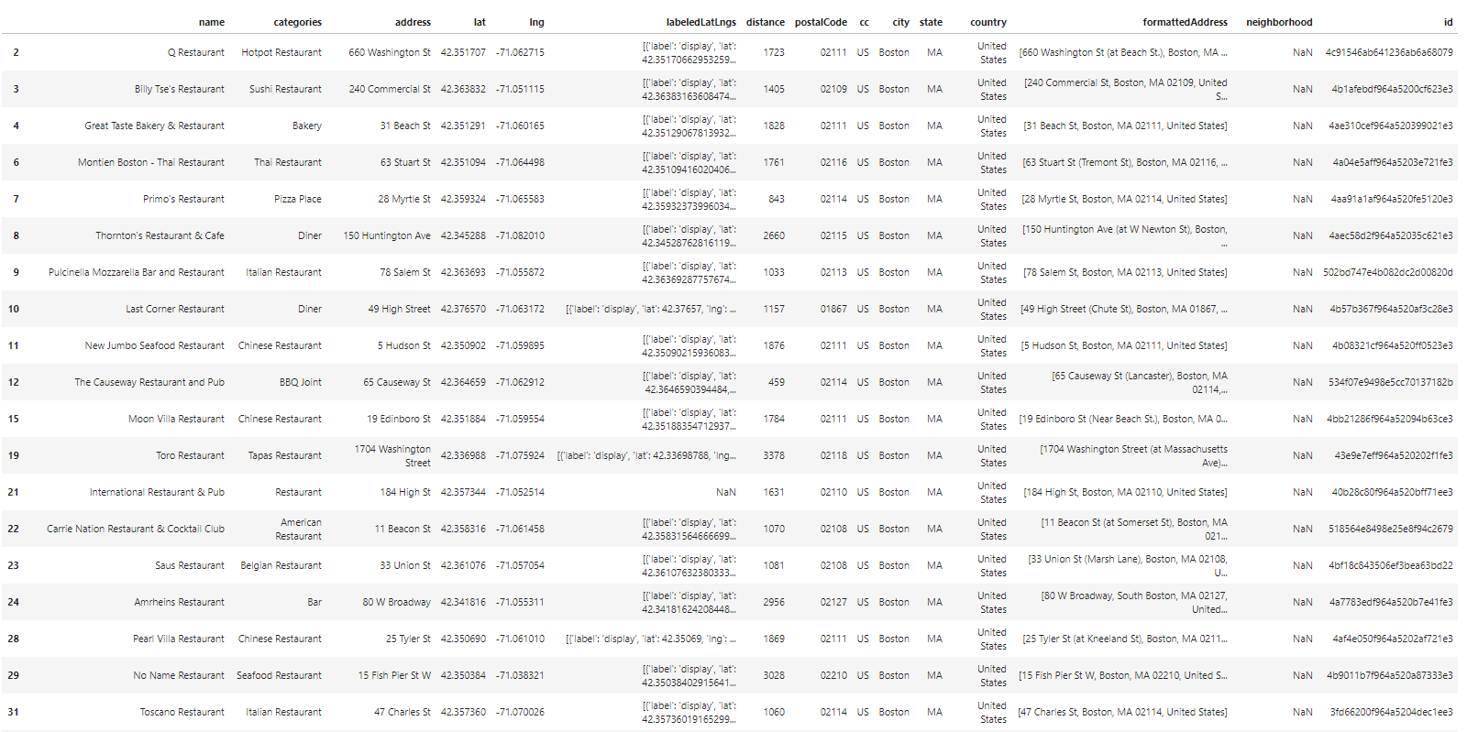
FourSquare data

Slide 8
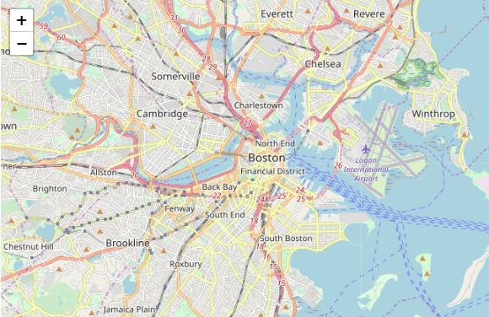
Methodology
Boston’s map
Data Analysis Now that the data is cleaned up it’s ready to be explored and analyzed in order to obtain insights. The data will be analyzed in the following order:
1. Crime data 2. School data 3. FourSquare data

Slide 9
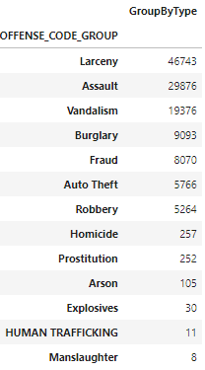
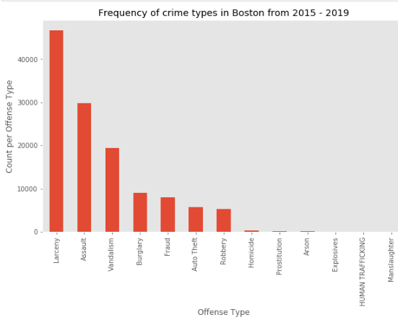
Crime data
The data was then grouped by type of crime from where it became apparent that the top crime type in Boston is larceny, followed by assault and then vandalism.

Slide 10
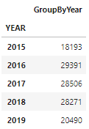
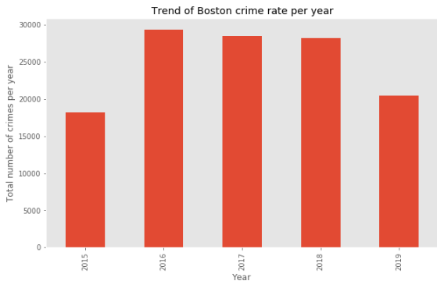
Crime data
the Boston crime trend, it can be seen that although there has been a significant increase in crime from 2015 to 2016, the crime rate has almost reverted back in 2019 to the rate seen in 2015 and the trend currently indicates a decrease in crime.

Slide 11
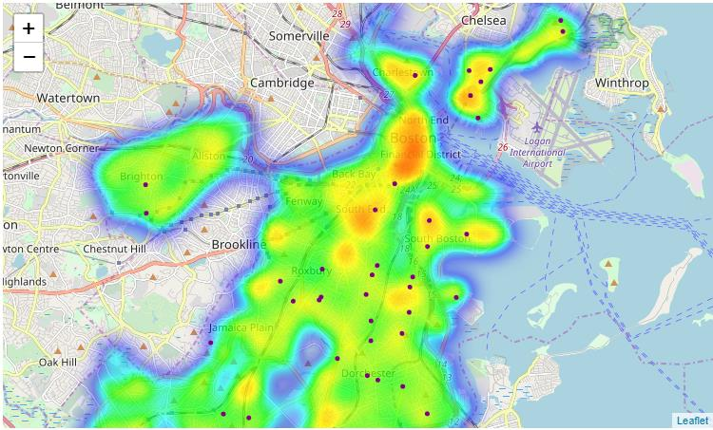
School data
For the school data it was ideal to highlight which neighborhood contains more than one elementary school. The schools were thus grouped by neighborhood and to display the density of schools per location visually, the data was overlaid as purple markers on the Boston base map which now included the crime data as well.

Slide 12
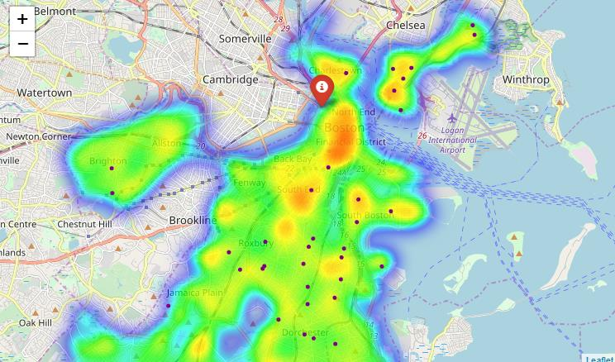
Foursquare data
The Museum’s location was then marked on the Boston base map as this will identify the center location to take into consideration when choosing a neighborhood to live in.

Slide 13
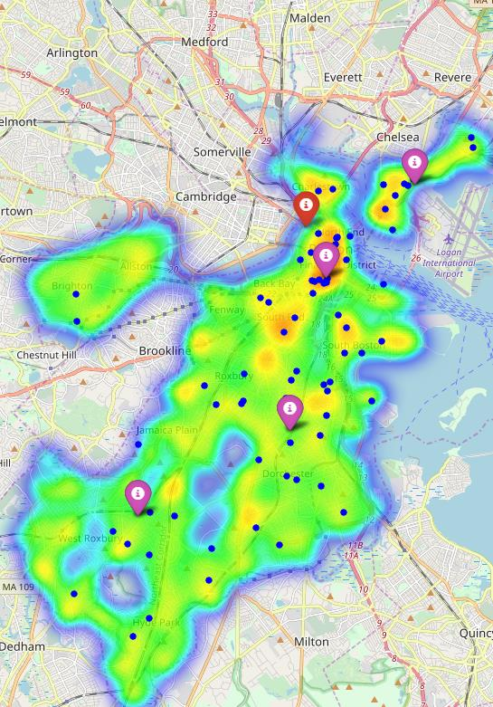
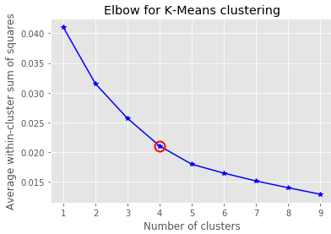
Building clusters using K-mean
The Euclidean distance for each point is calculated from the centroid and an elbow curve is developed to visually show the ideal number of clusters to continue with based on the data. It can be seen from figure 19 that a good K to use in the model will be 4.
The K-means model is then developed, and the data fitted to the model. 4 Clusters are then obtained and visually marked on the Boston map with a crime heat map, the museum data and the school data in the background as seen in the map pic.

Slide 14
Results
From the results the highest crime area is located around the Financial District (downtown Boston) close by Chinatown. This would not be an ideally suited neighborhood to select. Directing attention to the school data, it is beneficial if a neighborhood is chosen that provides multiple options, but it’s important to take note that where there are more options the neighborhood might also be considerably bigger than other neighborhoods. From the school results no conclusion can be made as yet on a preferred neighborhood as there are no immediate visible clusters. From the restaurant data, apart from the Chinese cuisine type clustered in Chinatown, there seems to be quite a variety of restaurants with various cuisine types all over Boston allowing for a variety of restaurants for a chef to work at. This data on its own does not provide a concrete solution for a neighborhood. From the clustering results of desirable traits (schools and restaurants) in a location, 4 neighborhoods were marked on a heat map of crime locations. These locations can then be further evaluated based on closer inspection or a zoomed in view of the map. As a final result, the four ideal neighborhoods to live in was marked with the following coordinates and upon further investigation the neighborhoods were determined:
• [ 42.30965123, -71.07414251] – Roxbury,
• [ 42.28570345, -71.13181767] – Roslindale,
• [ 42.35243914, -71.06025271] – Chinatown,
• [ 42.37861659, -71.0266932] – East Boston.
These markers only considered the positive attributes of neighborhoods, so when looking at figure 20 and including the crime heat map, it can be seen that Chinatown is located in a high crime location and is thus eliminated as a possible option for a neighborhood to consider. Final desirable neighborhoods to live in based on the induvial needs and location from the museum ideal neighborhoods to consider are then East Boston, Roxbury and Roslindale in no specific order.

Slide 15
Conclusion
The purpose of this project was met to leverage location data to assist an individual in his/her decision of which neighborhood to live in when relocating to an unfamiliar location The model developed assists in narrowing down ideal neighborhoods to select from based on stakeholder needs or preferences. Through clustering preferences, the cluster locations created is an ideal starting point for final exploration by the stakeholders. Final decision on the chosen neighborhood will be made by each stakeholder taking in their own needs and priorities into consideration.

